Slide 1

InvestIQ
by Team 02--> Techno Stack

Slide 2
Agenda
Team Member Roles and Responsibilities
Improvements from Professor Feedback
Project Description
Team Working Agreement
Personas
MVP
Technologies
Algorithms
Diagrams
Product Backlog
Sprint 3 Backlog
Metrics
Retrospective
Project Demo - Sprint 3
GitHub Link
Live Application Demo
Summary

Slide 3


Team Members
Ruchitha Reddy Kuthuru – Product Manager and Full Stack developer
Mahidhar Reddy Kandula – Machine learning Engineer

Slide 4


Team Members
Afrida Mehanaz Shaik– Machine Learning Engineer
Sharan Jagini – Backend Engineer and Tester

Slide 5


Team Members
Nadeem Hussain Shaik – Frontend Developer
Shrinidhi Daheechi – Frontend Developer

Slide 6
Problem Statement
Investors often find it challenging to make informed decisions due to overwhelming market information, constant fluctuations, and a lack of personalized guidance. Many existing tools provide data but do not offer meaningful insights tailored to individual needs. This app aims to simplify investment decisions by analyzing market trends, tracking relevant news, and offering timely recommendations based on personal financial goals and life events. Combining real-time updates with user-specific insights helps investors stay informed and make smarter financial choices with confidence.

Slide 7
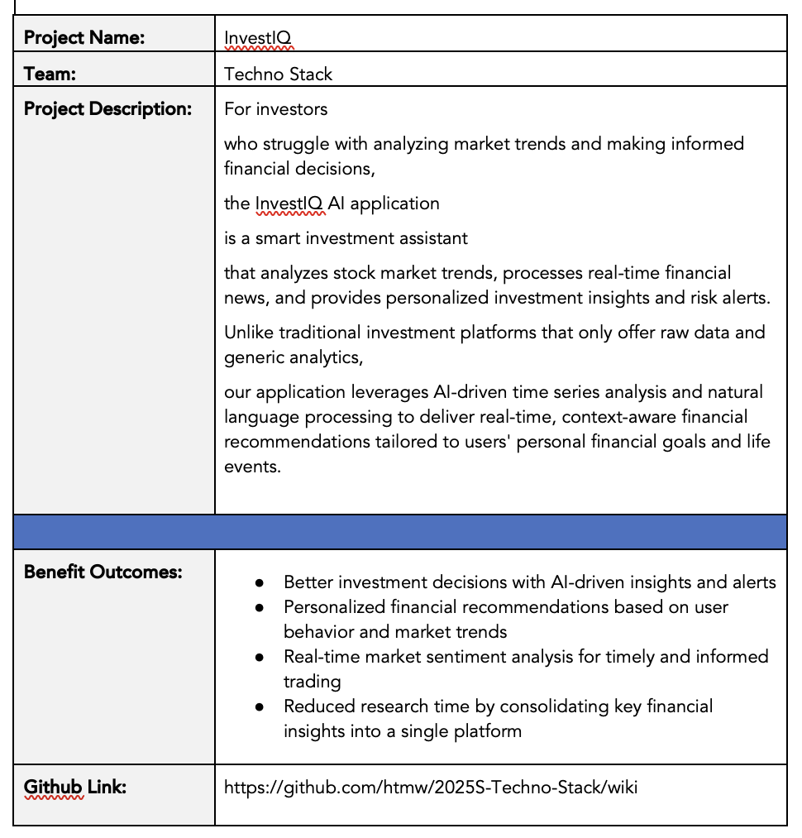
Project description

Slide 8
Improvements
Adding the improvements slide.
Adding the Historical team velocity graph
Writing the sprint recap more then 1 line.
Adding API Slide
Completing sprint planning
Showing code while explaining the demo and explaining it.

Slide 9
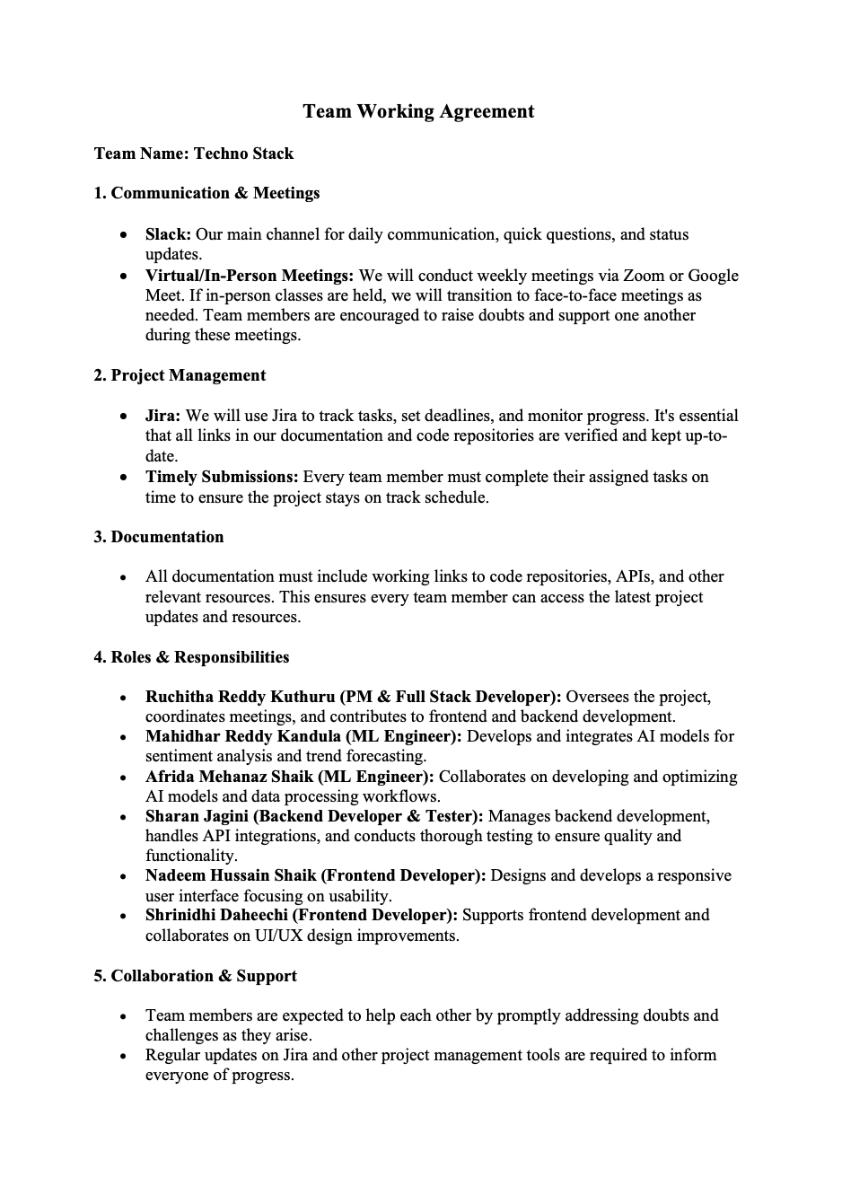

TEAM WORKING AGREEMENT

Slide 10

Persona
Aarav Sharma
Age: 28
Occupation: Software Engineer
Investment Experience: Intermediate
Goals: Simplify his investment decision-making process by utilizing clear, actionable insights from real-time news.
Pain Points: Feels overwhelmed by the vast amount of market data and frustrated by platforms that fail to provide timely news analysis.
Description: Aarav values technology and data-driven insights; he seeks a tool that aggregates real-time news, enabling him to quickly grasp market shifts without the distraction of raw stock data.
Challenges:
Struggles with filtering relevant financial information from the overwhelming amount of market data.
Finds it time-consuming to track news manually and correlate it with market trends.

Slide 11

Persona
Thomas Shelby
Age: 40
Occupation: Corporate Manager
Investment Experience: Beginner to Intermediate
Goals: Achieve steady portfolio growth by staying informed about key market developments through timely news updates.
Pain Points: Finds traditional investment platforms cluttered with irrelevant data and lacking a focused approach to current financial news.
Description: With a busy schedule, Thomas needs a user-friendly platform that provides curated real-time news and actionable insights, enabling him to make confident, long-term financial decisions without continuously monitoring fluctuating stock figures.
Challenges:
Has limited time to stay updated on financial news and market changes.
Prefers risk-averse investments but struggles with identifying safe and promising opportunities.

Slide 12

Persona
Sanjana Reddy
Age: 35
Occupation: Financial Analyst
Investment Experience: Advanced
Goals: Optimize her investment strategy with comprehensive market analysis based on the latest financial news.
Pain Points: Frustrated with generic investment tools that do not integrate timely news, leaving her without the nuanced insights she needs.
Description: Sanjana is analytical and detail-oriented, searching for a sophisticated platform emphasizing real-time news analysis to provide deep insights and tailored recommendations rather than just raw stock data.
Challenges:
Struggles with quickly assessing the sentiment of large volumes of financial news.
It requires advanced analytics but finds that many tools lack deep AI-driven insights.

Slide 13
MVP
User registration and profile setup (to capture financial goals, risk tolerance, and preferences).
Historical market trend analysis (using delayed or historical stock data from free APIs like Yahoo Finance or Alpha Vantage, which often provide historical data for free).
Personalized investment recommendations (based on historical trends, user goals, and risk tolerance, using a simple rule-based algorithm instead of real-time data).
A dashboard to view recommendations, historical trends, and market news.

Slide 14


Technologies - backend
Flask: A lightweight Python framework ideal for building RESTful APIs, easily integrating with machine learning models, and simplifying backend logic.
Node.js: Offers non-blocking, event-driven architecture, making it great for handling real-time operations and concurrent tasks.

Slide 15


Technologies - FRONTEND
Next.js: Offers server-side rendering and static site generation, resulting in fast, SEO-friendly pages and a strong user experience interface.
TypeScript: Improves code quality and maintainability by providing static type checking, which reduces runtime errors.

Slide 16

TECHNOLOGIES - DATABASE
PostgreSQL is a powerful, open-source relational database known for its reliability, scalability, and support for complex queries, ensuring secure and efficient data storage.

Slide 17

TECHNOLOGIES - APIS
Financial News API & Polygon API
These APIs supply real-time financial news and market data, enabling the application to deliver timely and actionable insights without relying on raw stock data.

Slide 18

TECHNOLOGIES – MACHINE LEARNING
PyTorch is selected for its dynamic computation graph and user-friendly interface, making it ideal for developing and training deep learning models used in sentiment analysis and trending forecasting.

Slide 19


TECHNOLOGIES – Hosting & Deployment
Vercel: Perfect for quickly deploying frontend applications with high performance and scalability.
DigitalOcean: Offers dependable and scalable hosting for backend services and the entire application deployment.

Slide 20





TECHNOLOGIES – Development Tools
Visual Studio Code: A versatile code editor featuring extensive extensions and integrated debugging that enhances the developer experience productivity.
Postman: Essential for testing APIs, confirming our endpoints function as expected during development.
Git: To enable version control, enhance collaborative development, and improve code management.
Docker: Used for containerization, ensuring consistency across development, testing, and production environments.
Slack: Facilitates effective team communication and project management.

Slide 21

Algorithms - nlp
Our NLP module harnesses cutting-edge technology. The phi model for natural language processing is specifically designed to analyze real-time financial news. This module extracts sentiment and identifies key topics from the latest updates, enabling the application to interpret market sentiment accurately. By processing large volumes of textual data, the phi model provides actionable insights that inform users about market trends and emerging financial narratives, transforming raw news into clear, meaningful investment opportunities guidance.

Slide 22
Algorithms – TIME SERIES
Our Time Series Analysis module examines historical stock market data using advanced deep learning techniques like LSTM and Temporal Fusion Transformers to capture underlying trends and seasonal patterns. This analysis provides essential context that complements the real-time insights derived from our NLP module, ensuring users have a strong understanding of market dynamics. Together, these two modules generate a strong synergy that enables investors to make informed decisions based on current news sentiment and historical market performance.

Slide 23
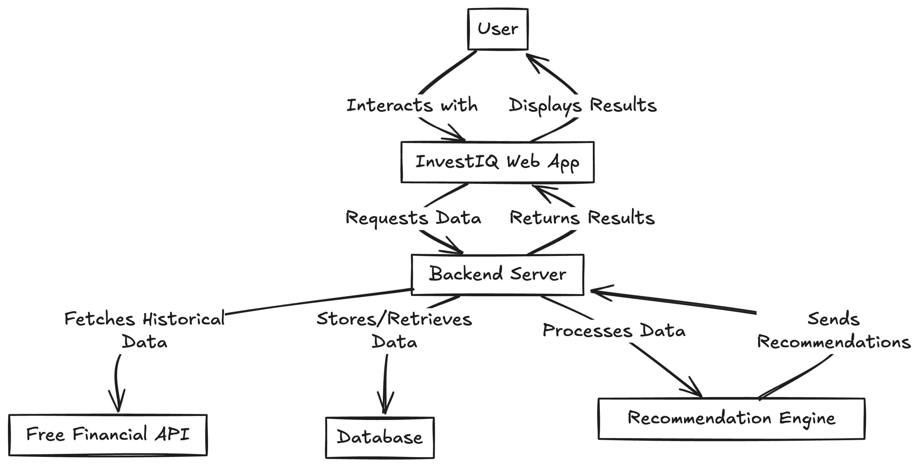
Architecture Diagram

Slide 24
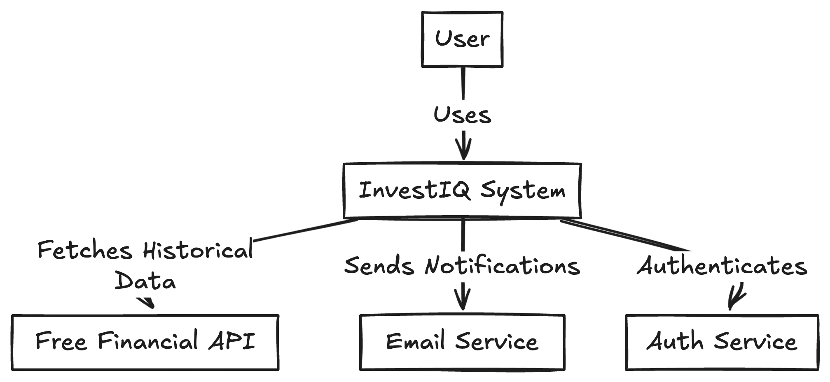
Context Diagram

Slide 25
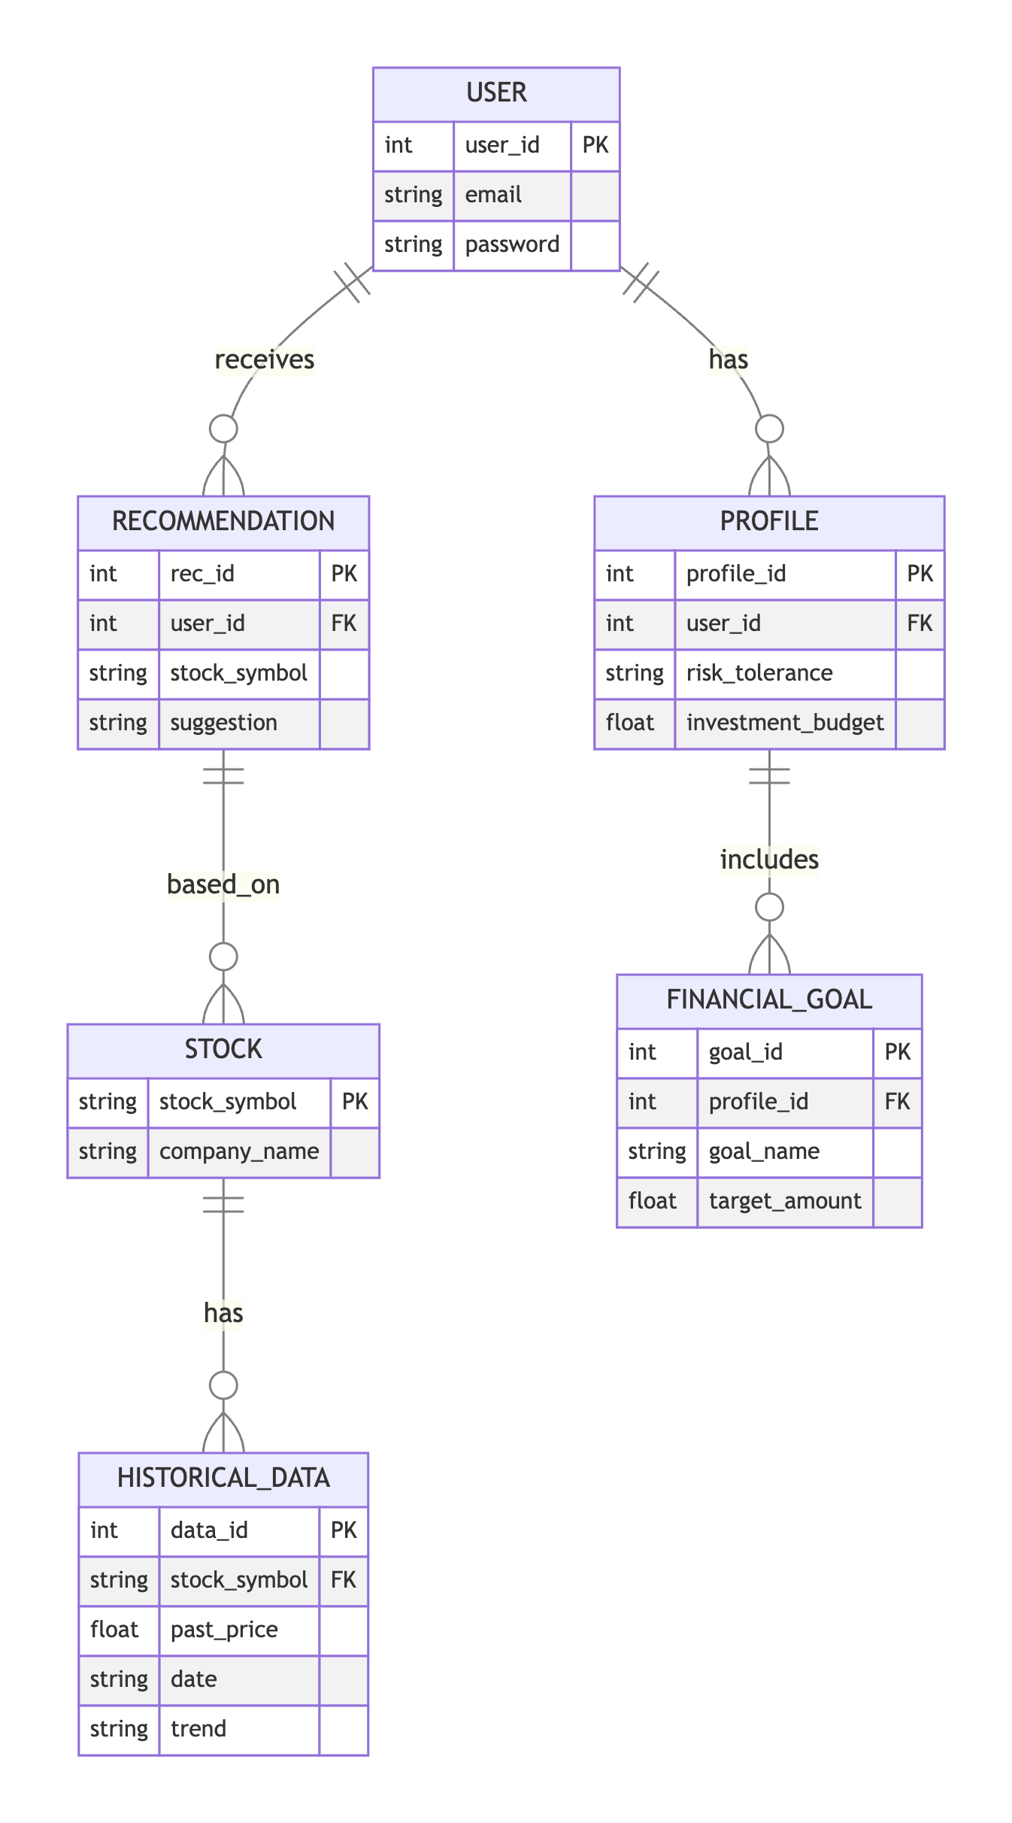
ER Diagram (Entity-Relationship Diagram)

Slide 26
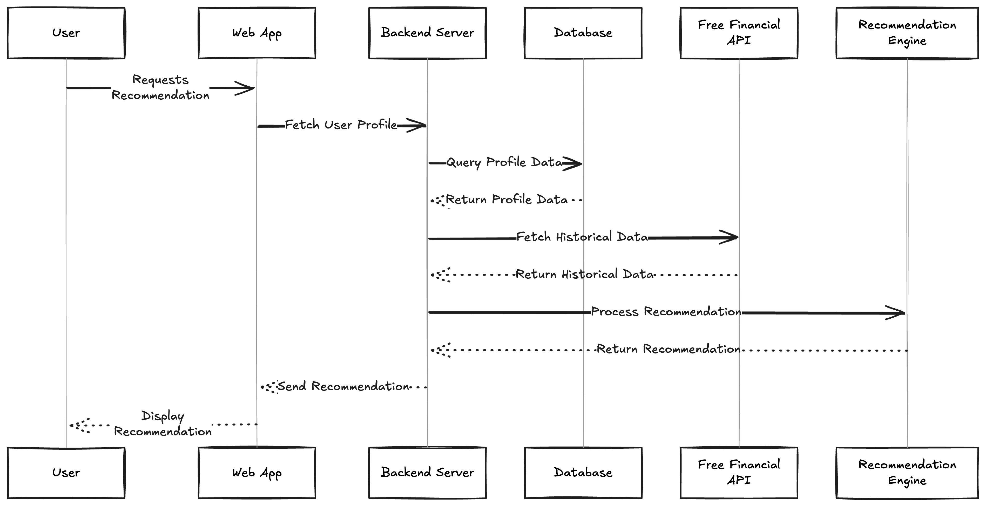
Sequence Diagram

Slide 27
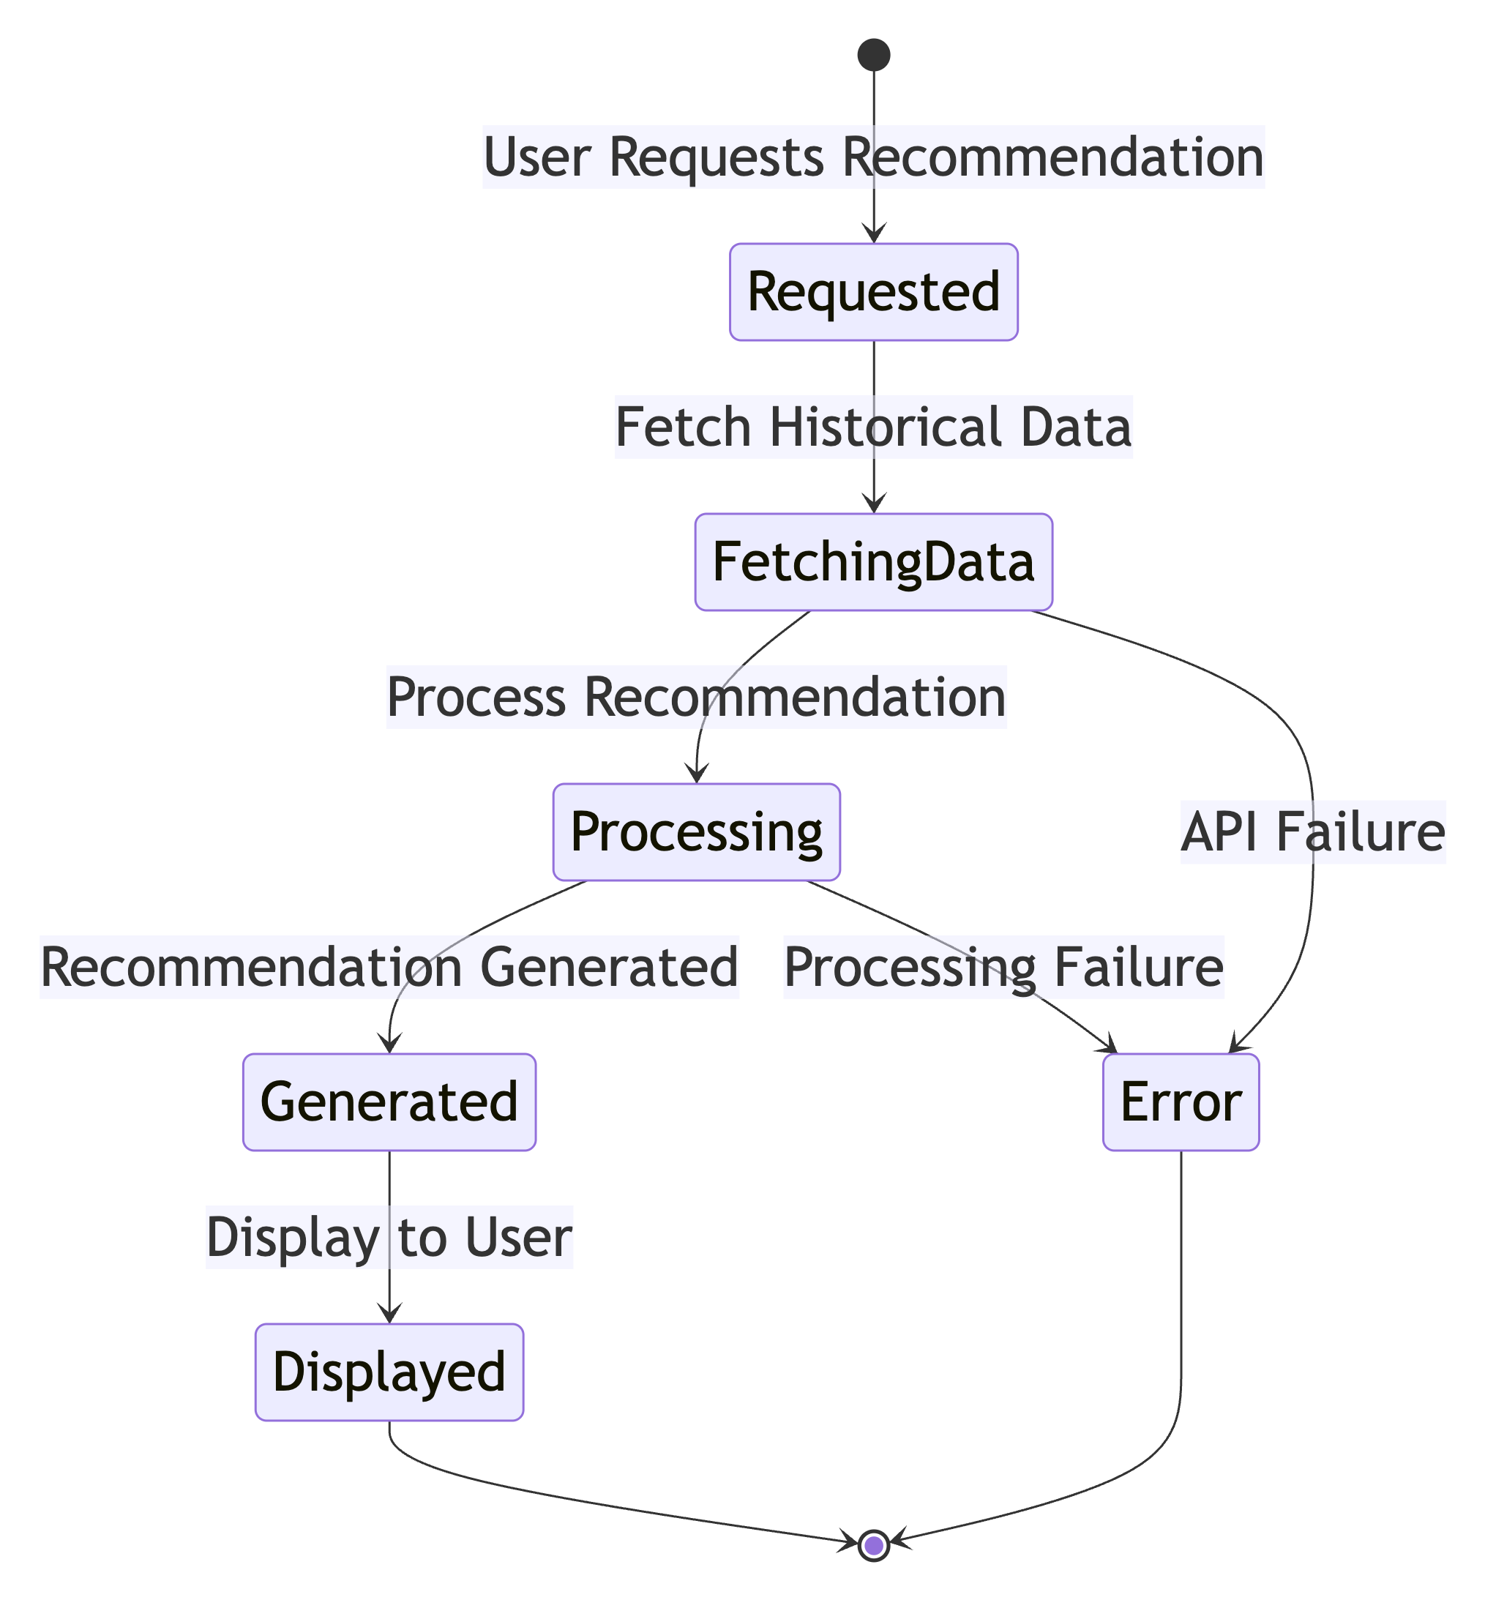
State Diagram

Slide 28
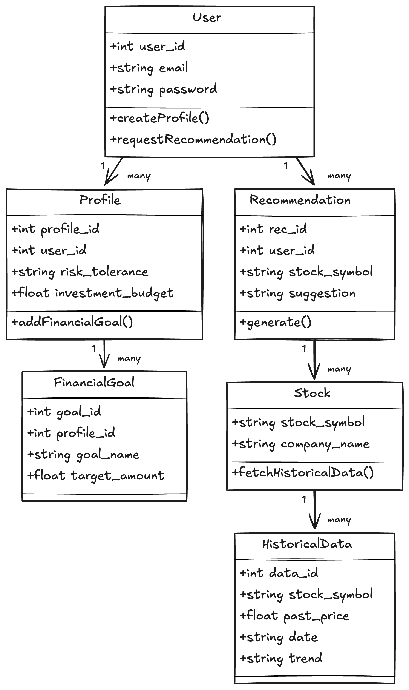
Class Diagram

Slide 29
Sprint 2 Recap
During Sprint 2, the team focused on backend development by completing key tasks such as saving user profile data (US6), integrating an external API for historical stock data (TS2), and setting up the database schema (TS3). These foundational elements were successfully implemented, enabling future features. However, user registration (US4) and login (US5) remained incomplete due to backend dependencies and time limitations. Out of 16 planned story points, 11 were completed. The sprint revealed the need for better coordination between backend and frontend tasks and improved planning for critical user flows in upcoming sprints.

Slide 30
Product Backlog
Story ID | Feature | User Story | Acceptance Criteria | Story Points
US1 | Basic Dashboard UI | Aarav Sharma wants to see a basic dashboard layout, So that he can understand the structure of the app. | Dashboard has sections for recommendations, trends, and news (placeholders). Layout is clean with a header, sidebar, and main content area. UI is responsive for desktop and mobile. | 5
US2 | Profile Setup UI | Aarav Sharma wants to input his risk tolerance and budget in a form, So that he can simulate setting up his profile. | Form includes dropdown for risk tolerance (Low, Medium, High) and input for budget. Form has a “Save” button that shows a confirmation message (no backend saving yet). Error message shown if budget is invalid (e.g., negative). | 3
US3 | Recommendation Placeholder UI | Thomas Shelby wants to see a placeholder for recommendations, So that he can visualize where his investment suggestions will appear. | Dashboard has a section titled “Recommendations”. Section shows 3 mock recommendations (e.g., “Stock: AAPL, Suggestion: Buy”). Each recommendation has a button labeled “View Details” (non-functional for now). | 3
TS1 | Front-End Framework Setup | As a developer needs to set up a front-end framework (e.g., React), So that the team can build the UI efficiently. | Project is initialized with React (or similar framework). Basic routing is set up for dashboard and profile pages. CSS framework (e.g., Tailwind or Bootstrap) is integrated for styling. | 5

Slide 31
Product Backlog
Story ID | Feature | User Story | Acceptance Criteria | Story Points
US4 | User Registration | Aarav Sharma wants to register with his email and password, So that he can access the InvestIQ platform. | Aarav can enter email and password on a registration form. System validates email format and ensures password is at least 8 characters. Upon successful registration, Aarav is redirected to login page. 4. Error messages shown if email is in use or inputs are invalid. | 3
US5 | User Login | Aarav Sharma wants to log in with his email and password, So that he can access his dashboard. | Aarav can enter email and password on a login form. System validates credentials and logs Aarav in if correct. Aarav is redirected to the dashboard upon successful login. Error message shown if credentials are incorrect. | 2
US6 | Save Profile Data | Aarav Sharma wants to save his profile data, So that the system can use it for recommendations. | Profile form (built in Sprint 1) now saves data to the backend. Aarav can edit and update his profile. Confirmation message shown after saving. | 3
TS2 | Backend API Integration | As a developer needs to integrate a free API (e.g., Yahoo Finance) to fetch historical stock data, So that the team can use it for recommendations. | Backend fetches historical stock data for 5 sample stocks (e.g., AAPL, GOOGL). Data includes 30 days of historical prices and trends. Data is cached in the database. Error handling for API failures. | 5

Slide 32
Product Backlog
Story ID | Feature | User Story | Acceptance Criteria | Story Points
TS3 | Database Schema Setup | Sanjana Reddy needs to create a database schema for users, profiles, and historical data, So that the team can store and retrieve data. | Schema includes tables for Users, Profiles, and HistoricalData. Database uses a free solution (e.g., SQLite). Basic CRUD operations implemented for user and profile data. | 3
US7 | Historical Trends Display | Thomas Shelby wants to see historical trends for recommended stocks, So that he can understand the basis for recommendations. | Dashboard displays a line chart showing 30-day price trend for each stock. Chart uses historical data from the database. Chart includes labels for dates and prices. | 5
US8 | Market News Display | Thomas Shelby wants to see recent market news, So that he can stay informed. | Dashboard includes a section with market news headlines. News fetched from a free API (e.g., NewsAPI) and displayed as a list. Each news item includes title, source, and link to the article. | 5
US9 | Personalized Recommendations | Thomas Shelby wants to see personalized investment recommendations, So that he can make informed decisions. | Recommendations replace the placeholder UI from Sprint 1. Recommendations are based on historical trends and user profile (e.g., risk tolerance). If no recommendations are available, a message like “No recommendations at this time” is shown. | 5

Slide 33
Product Backlog
Story ID | Feature | User Story | Acceptance Criteria | Story Points
TS4 | Recommendation Logic | As a developer needs to implement a rule-based recommendation system, So that users receive personalized suggestions. | Algorithm uses historical trends (e.g., 30-day moving average) and user risk tolerance. Example rule: Recommend stocks with upward trends for low-risk users. Logic is tested with sample profiles and data. | 5
TS5 | News API Integration | As a developer needs to integrate a free news API (e.g., NewsAPI), So that the team can display market news. | Backend fetches news articles related to finance. News data is cached for 24 hours. Error handling for API failures. | 3

Slide 34
Sprint 1 Summary
Sprint 1 focused on setting up the project foundation. The team completed the basic dashboard UI, profile setup form, and a placeholder for investment recommendations. Additionally, the front-end framework was configured with routing and styling tools. This sprint laid the groundwork for future user interactions and functional development.

Slide 35
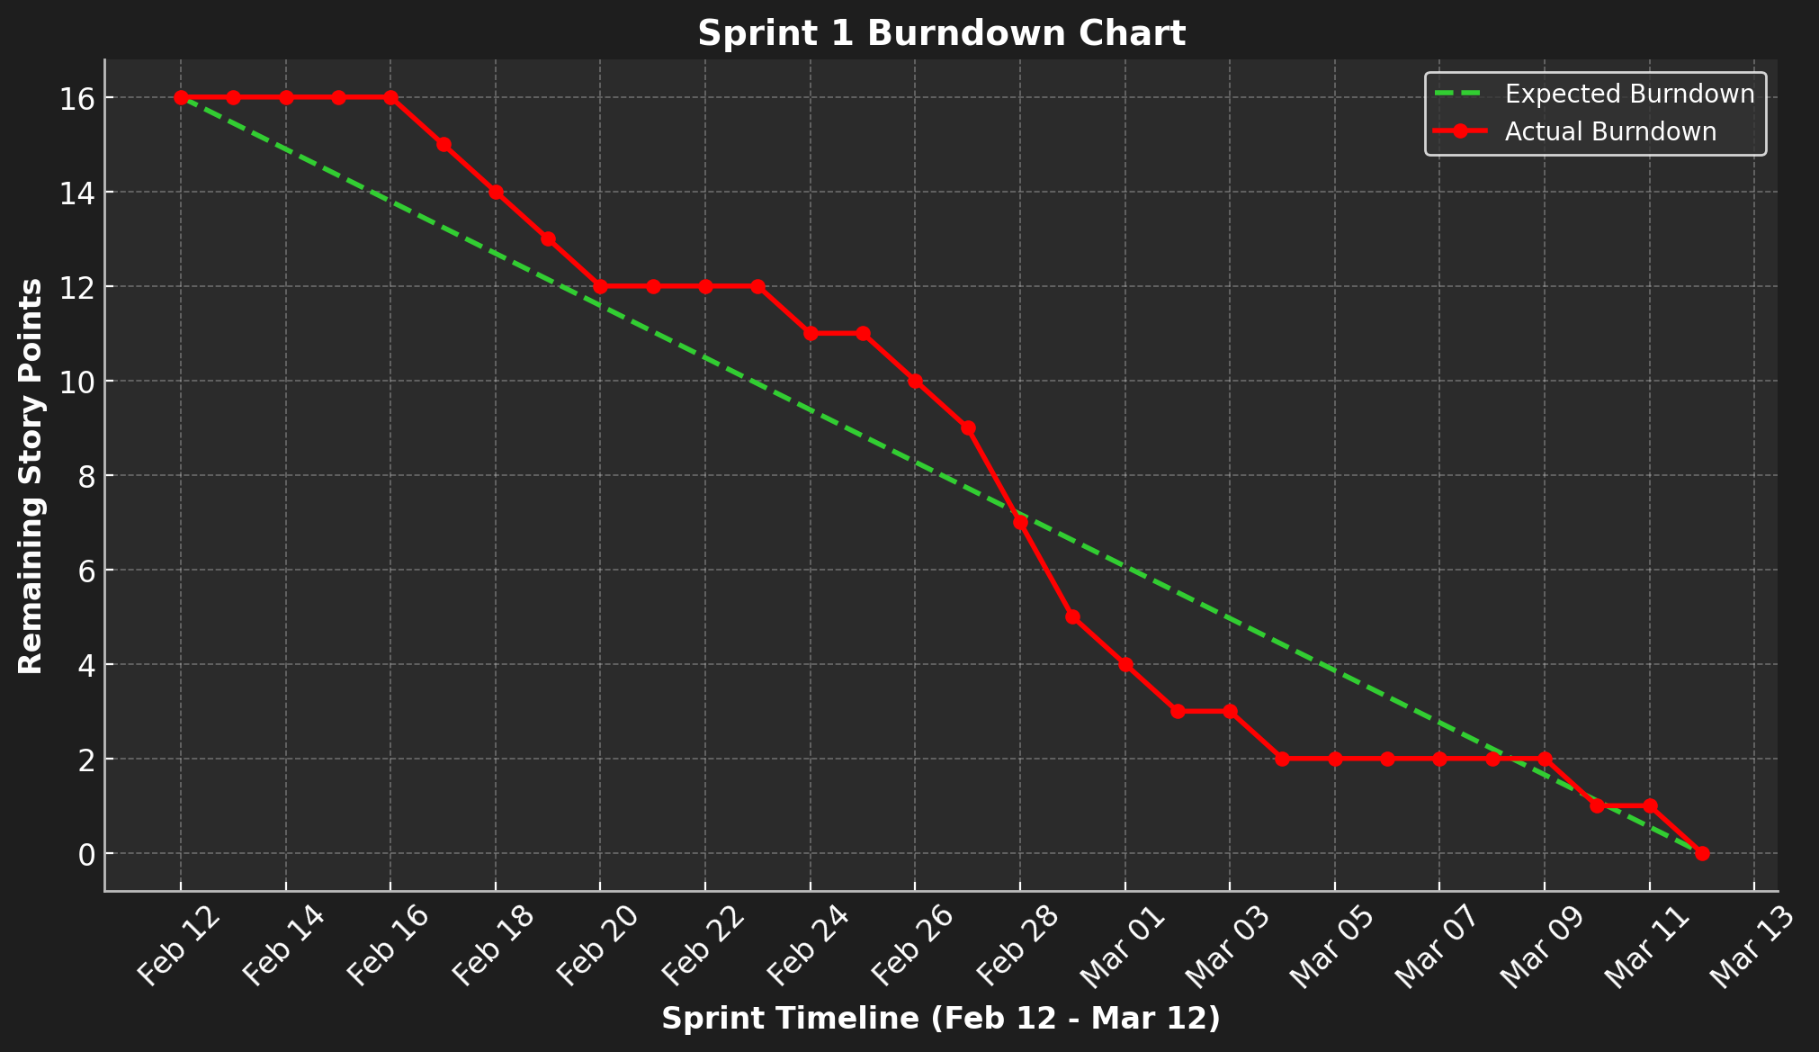
Burndown chart Sprint 1

Slide 36
Sprint 2 Summary
In Sprint 2, the team focused on backend setup and completed profile data saving, API integration, and database schema. However, user registration and login remained incomplete due to dependencies. A total of 11 out of 16 story points were completed, highlighting planning gaps and the need for better coordination.

Slide 37
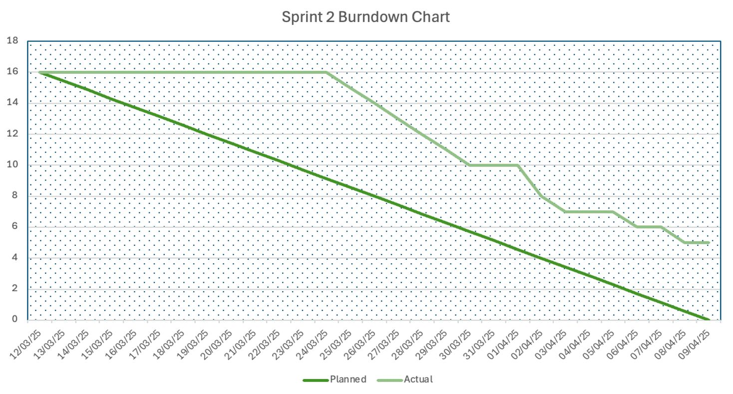
Burndown chart Sprint 2

Slide 38
Sprint 3 BACKLOG
Story ID | Feature | User Story | Acceptance Criteria | Story Points
US7 | Historical Trends Display | Thomas Shelby wants to see historical trends for recommended stocks, So that he can understand the basis for recommendations. | 1.Dashboard displays a line chart showing 30-day price trend for each stock. 2.Chart uses historical data from the database. 3.Chart includes labels for dates and prices. | 5
US8 | Market News Display | Thomas Shelby wants to see recent market news, So that he can stay informed. | 1.Dashboard includes a section with market news headlines. 2.News fetched from a free API (e.g., NewsAPI) and displayed as a list. 3.Each news item includes title, source, and link to the article. | 5
US9 | Personalized Recommendations | Thomas Shelby wants to see personalized investment recommendations, So that he can make informed decisions. | 1.Recommendations replace the placeholder UI from Sprint 1. 2.Recommendations are based on historical trends and user profile (e.g., risk tolerance). 3.If no recommendations are available, a message like “No recommendations at this time” is shown. | 5
TS4 | Recommendation Logic | As a developer needs to implement a rule-based recommendation system, So that users receive personalized suggestions. | 1.Algorithm uses historical trends (e.g., 30-day moving average) and user risk tolerance. 2.Example rule: Recommend stocks with upward trends for low-risk users. 3.Logic is tested with sample profiles and data. | 5

Slide 39
Sprint 3 BACKLOG
Story ID | Feature | User Story | Acceptance Criteria | Story Points
TS5 | News API Integration | As a developer needs to integrate a free news API (e.g., NewsAPI), So that the team can display market news. | 1.Backend fetches news articles related to finance. 2.News data is cached for 24 hours. 3.Error handling for API failures. | 3
US4 | User Registration | Aarav Sharma wants to register with his email and password, So that he can access the InvestIQ platform. | Aarav can enter email and password on a registration form. System validates email format and ensures password is at least 8 characters. Upon successful registration, Aarav is redirected to login page. 4. Error messages shown if email is in use or inputs are invalid. | 3
US5 | User Login | Aarav Sharma wants to log in with his email and password, So that he can access his dashboard. | Aarav can enter email and password on a login form. System validates credentials and logs Aarav in if correct. Aarav is redirected to the dashboard upon successful login. Error message shown if credentials are incorrect. | 2

Slide 40
Test Cases Sprint 3
Test Case ID | Story ID | Feature | Test Description | Test Steps | Expected Result | Actual Result | Status
TC3.1 | US7 | Historical Trends Display | Display 30-day trend chart | Navigate to dashboard View historical trends section Verify chart loads | Chart displays 30-day price data with labels | Chart loaded correctly with date and price labels | Pass
TC3.2 | US7 | Historical Trends Display | Chart uses database data | Disconnect API Reload dashboard Verify data comes from DB cache | Chart still displays using database-stored data | Chart used cached data and displayed correctly | Pass
TC3.3 | US8 | Market News Display | Display market news list | Navigate to dashboard View news section Check for title, source, and link | News list displays with valid title, source, and clickable link | News displayed with all required fields | Pass

Slide 41
Test Cases Sprint 3
Test Case ID | Story ID | Feature | Test Description | Test Steps | Expected Result | Actual Result | Status
TC3.4 | US8 | Market News Display | Handle API failure | Simulate API failure Load dashboard Observe behavior | Graceful error message shown if API fails | API failed, error handled with proper message | Pass
TC3.5 | US9 | Personalized Recommendations | Show personalized recommendations | Login with filled profile Open dashboard Verify recommendations | Recommendations shown based on profile risk and trends | Correct personalized recommendations displayed | Pass
TC3.6 | US9 | Personalized Recommendations | No recommendations fallback | Login with empty profile Open dashboard Verify fallback message | Message “No recommendations at this time” is shown | Proper fallback message shown | Pass

Slide 42
Test Cases Sprint 3
Test Case ID | Story ID | Feature | Test Description | Test Steps | Expected Result | Actual Result | Status
TC3.7 | TS4 | Recommendation Logic | Apply logic for low-risk user | Set profile to low risk Check suggestions Validate logic | Recommended stocks follow logic (e.g., upward trend for low risk) | Recommendations matched rule-based logic | Pass
TC3.8 | TS4 | Recommendation Logic | Logic tested with sample data | Add sample data Trigger logic Verify against rules | Logic runs correctly for sample input profiles | Algorithm applied and validated successfully | Pass
TC3.9 | TS5 | News API Integration | Fetch news articles | Call backend API Check response Ensure content is finance-related | Finance-related news articles returned | API returned valid financial news articles | Pass

Slide 43
Test Cases Sprint 3
Test Case ID | Story ID | Feature | Test Description | Test Steps | Expected Result | Actual Result | Status
TC3.10 | TS5 | News API Integration | Cache validation | Fetch news Re-fetch within 24 hrs Compare response | News should be cached and unchanged during cache window | News data returned from cache, no new API call | Pass

Slide 44
Stories Completed in Sprint 3
Story ID | Feature | Story Points
US7 | Historical Trends Display | 5
US8 | Market News Display | 5
US9 | Personalized Recommendations | 5
TS4 | Recommendation Logic | 5
TS5 | News API Integration | 3
US4 | User Registration | 3
US5 | User Login | 2
Total |  | 28

Slide 45
Team Velocity
Total Story Points Committed: 28
Story Points Completed: 28
Team Velocity (Sprint 3): 28 story points

Slide 46
Historical Team Velocity
Sprint | Velocity (Story Points)
Sprint 1 | 16
Sprint 2 | 11
Sprint 3 | 28
Average | 18.33

Slide 47
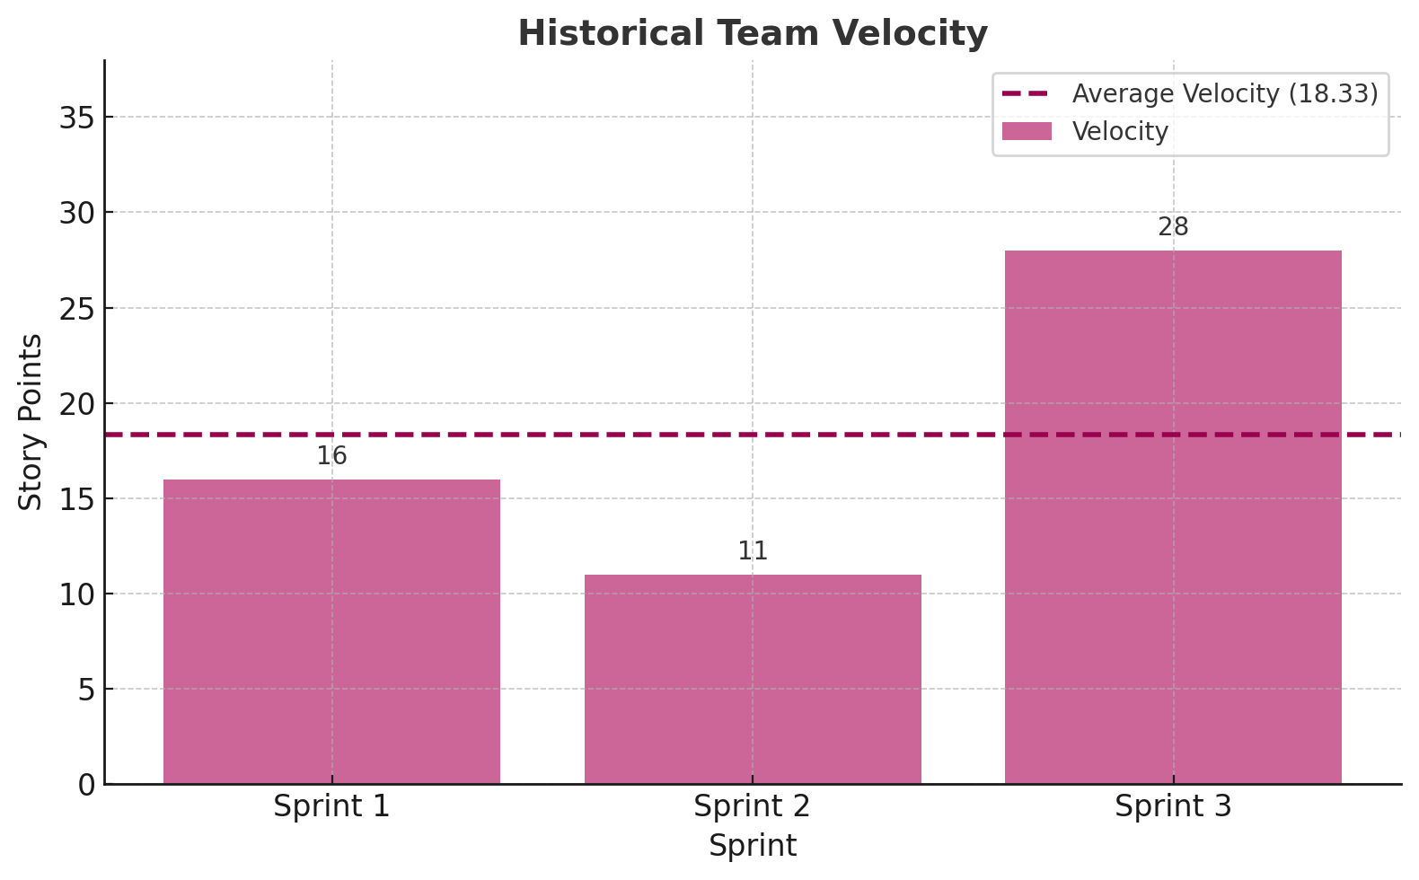
Historical Team Velocity Bar chart

Slide 48
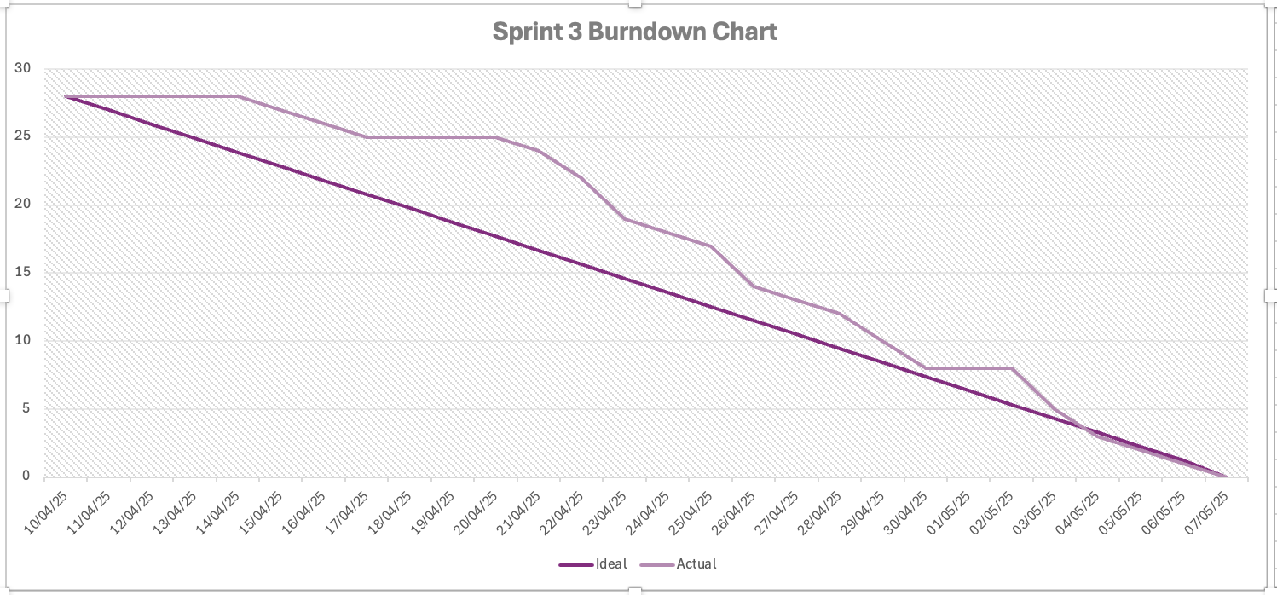
Burndown chart

Slide 49
Completed/Committed Ratio - Sprint 3
Committed Story Points: 28
Completed Story Points: 28
Completed/Committed Ratio: (28/28) × 100 = 100%

Slide 50
HISTORICAL Completed/Committed Ratio
Sprint | Committed | Completed | Ratio (%)
Sprint 1 | 16 | 16 | 100%
Sprint 2 | 16 | 11 | 68.75%
Sprint 3 | 28 | 28 | 100%
Average | — | — | 89.58%

Slide 51
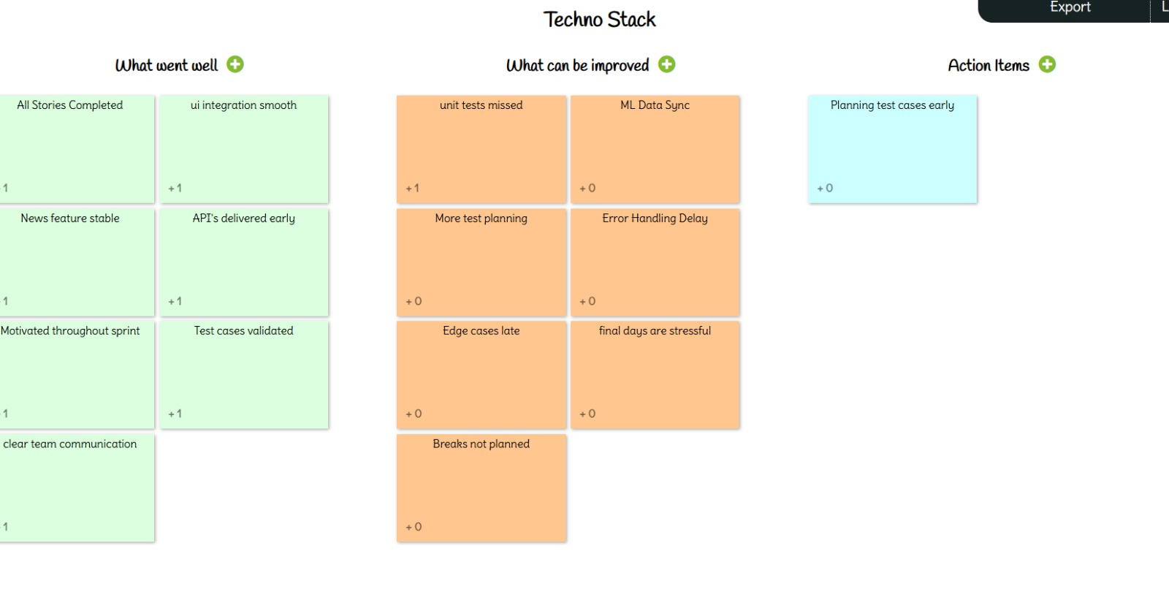
retrospective

Slide 52
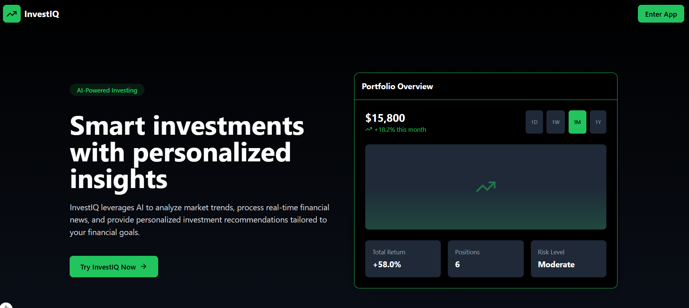
Screenshots

Slide 53
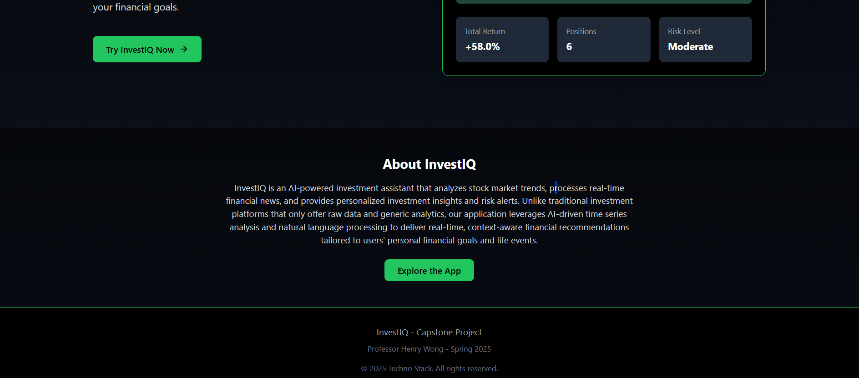
Screenshots

Slide 54
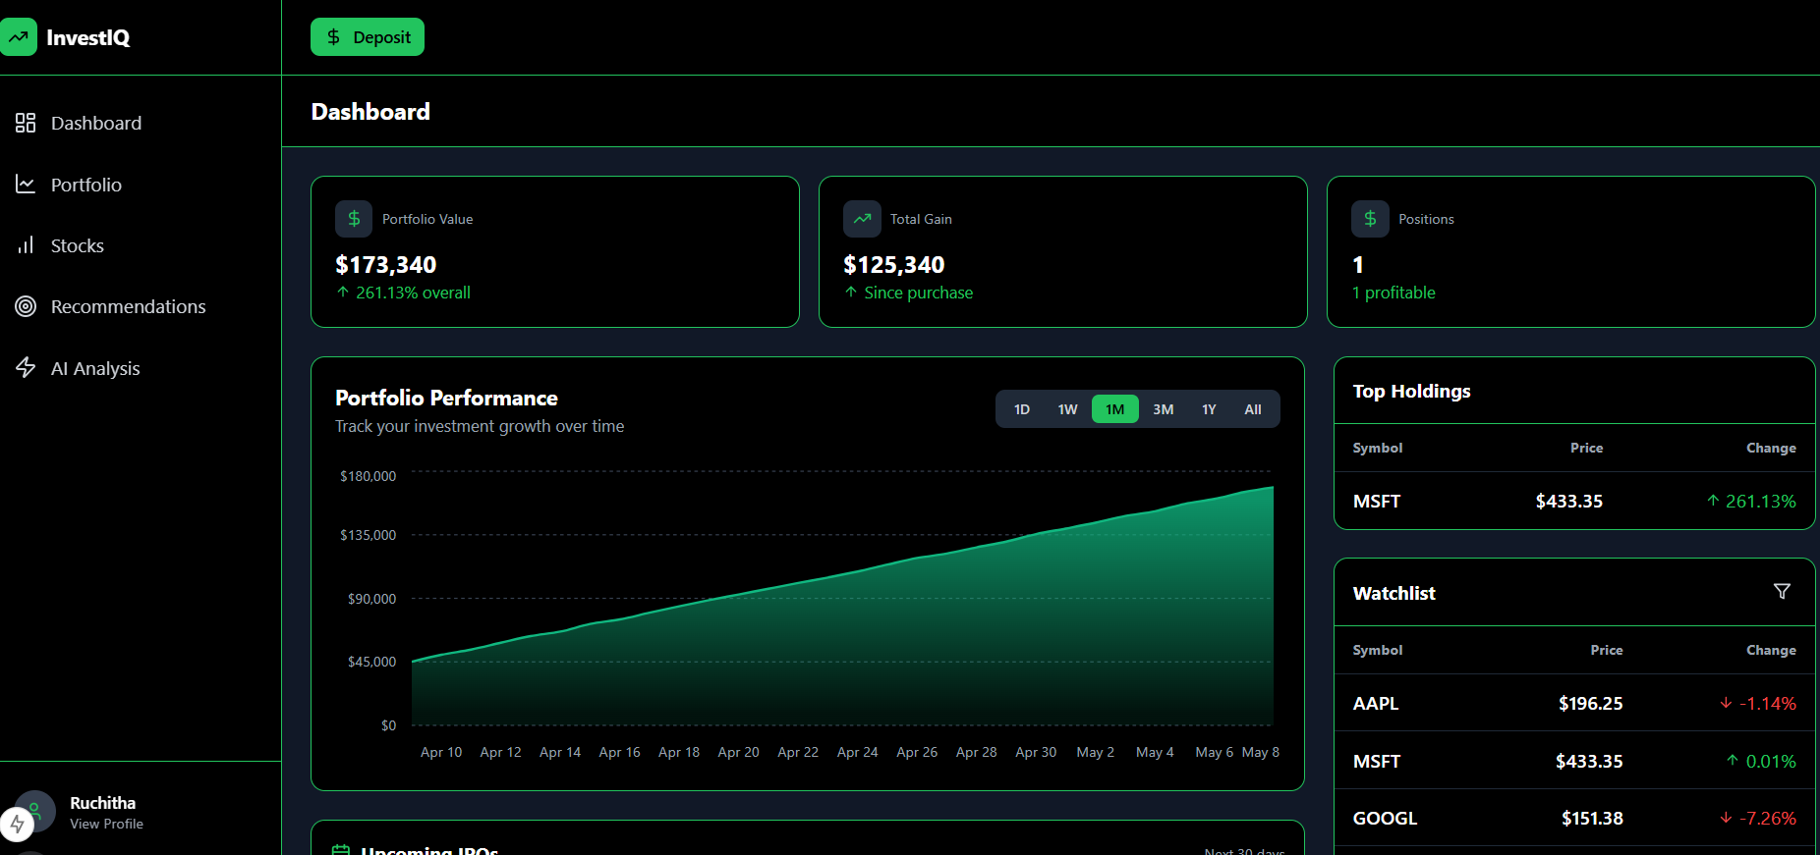
Screenshots

Slide 55
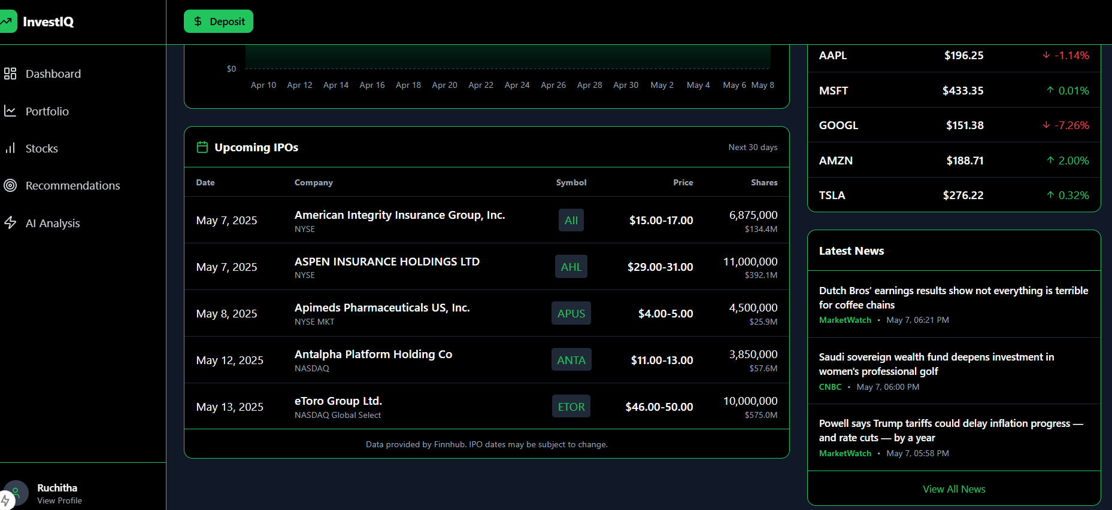
screenshots

Slide 56
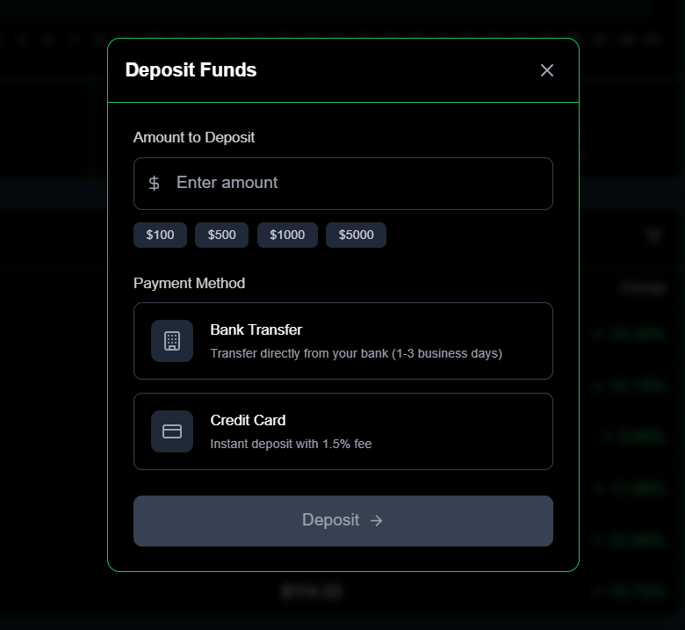
Screenshots

Slide 57
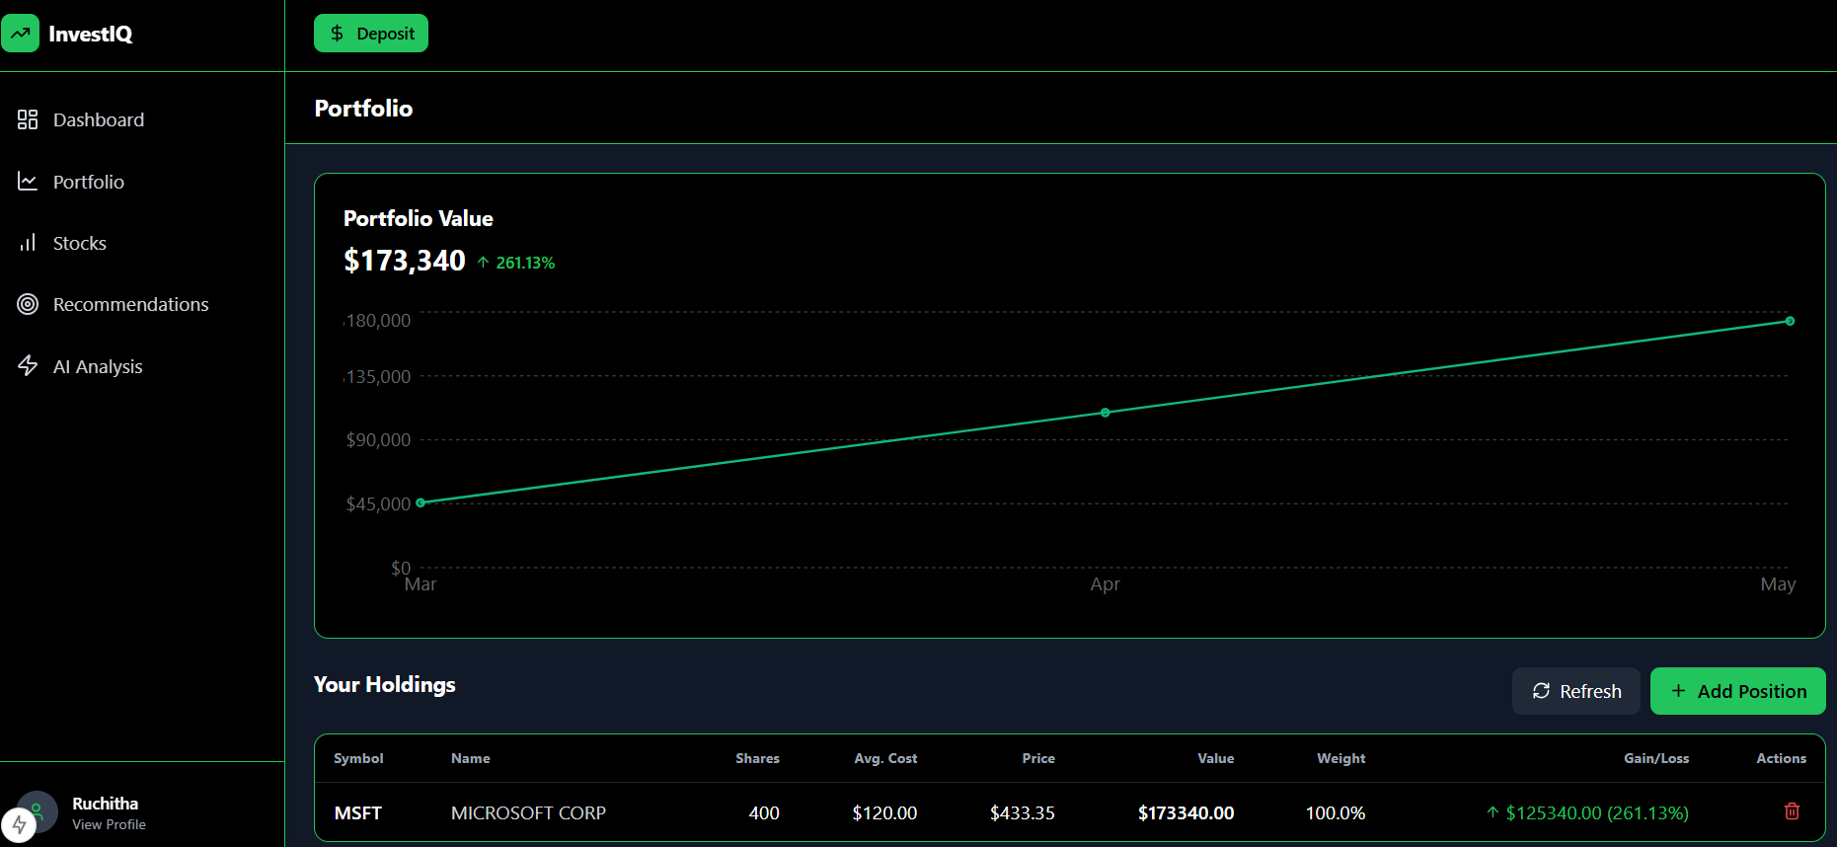
Screenshots

Slide 58
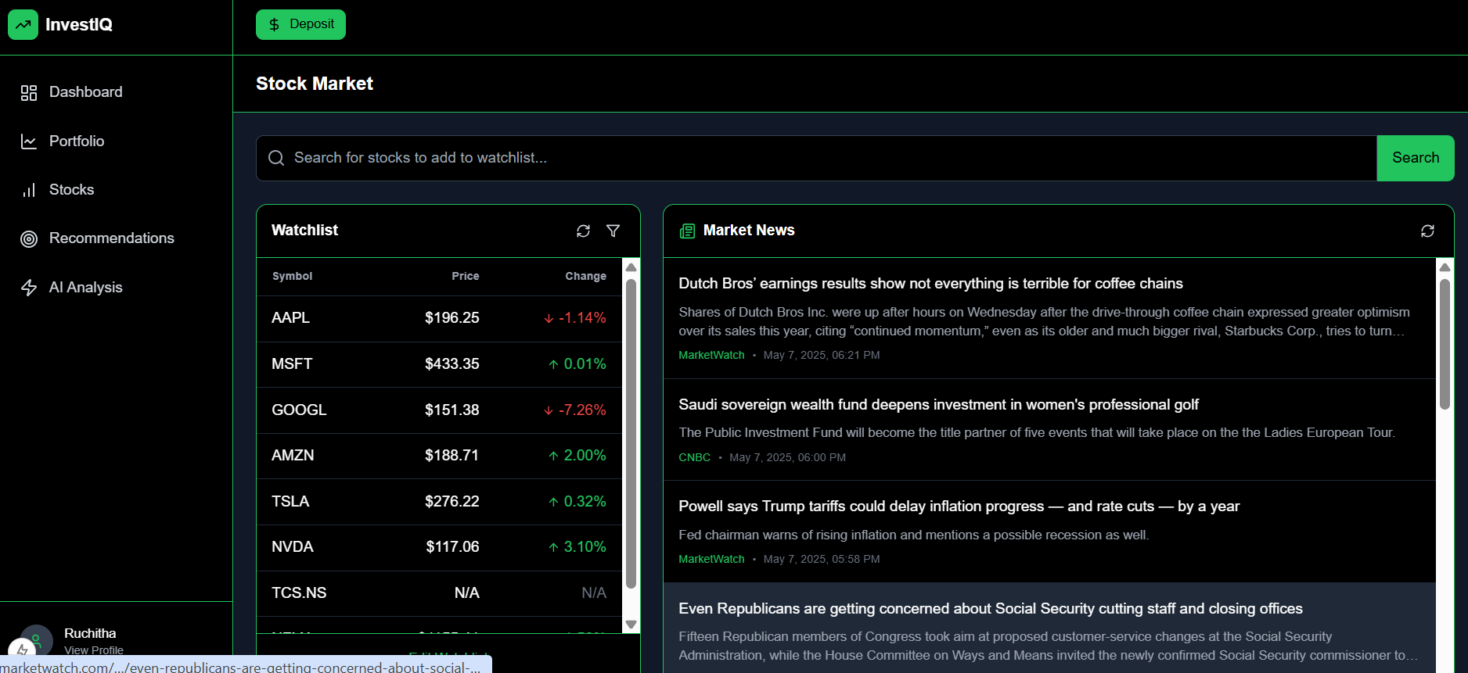
Screenshots

Slide 59
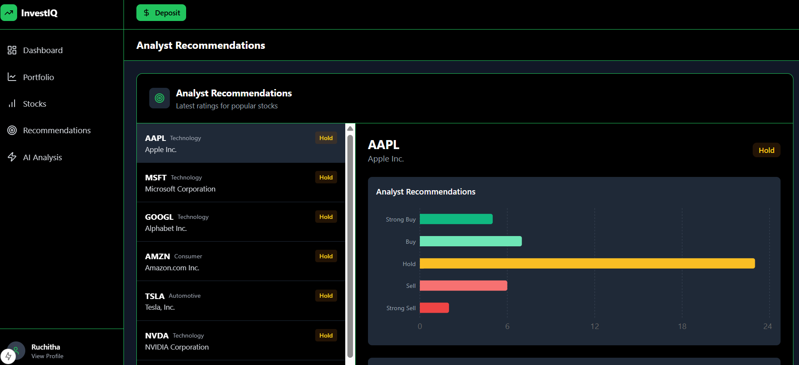
screenshots

Slide 60
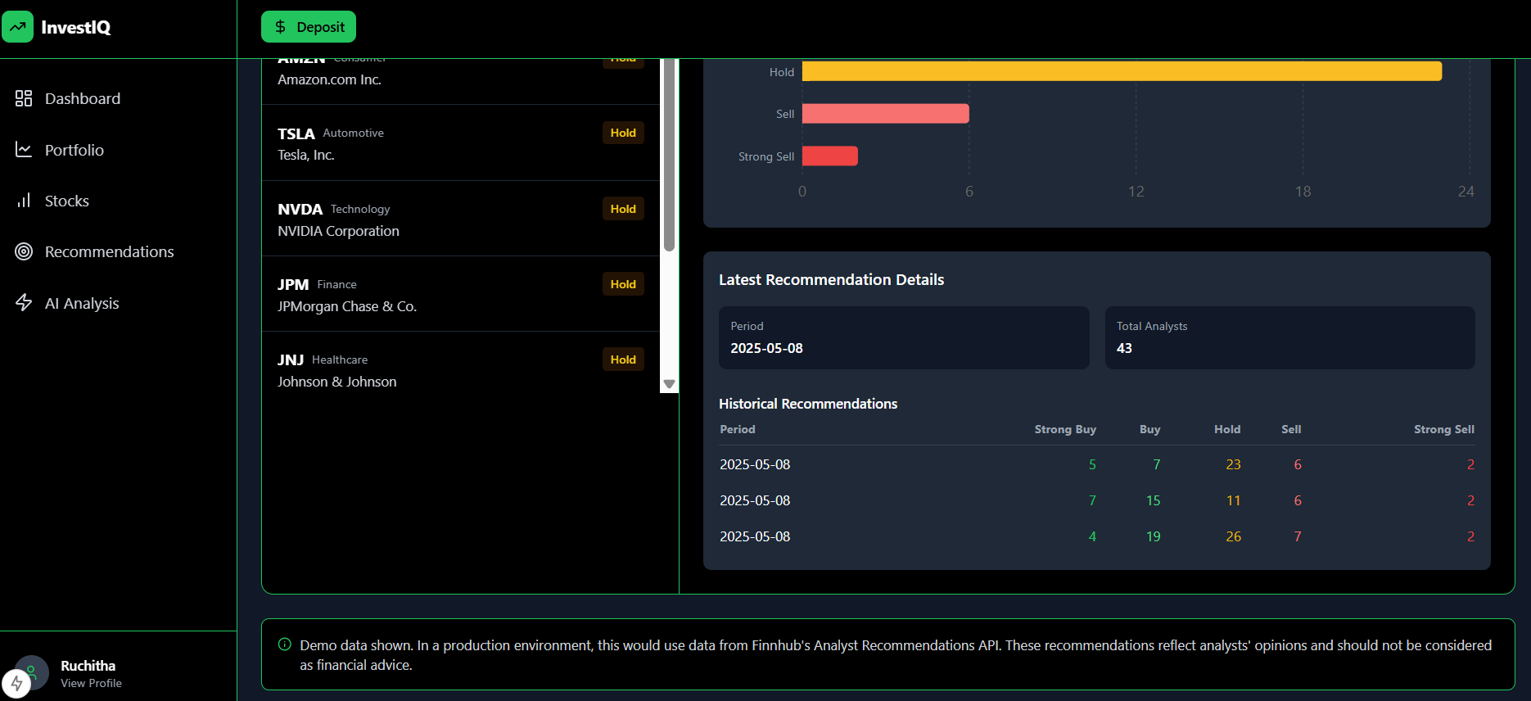
Screenshots

Slide 61
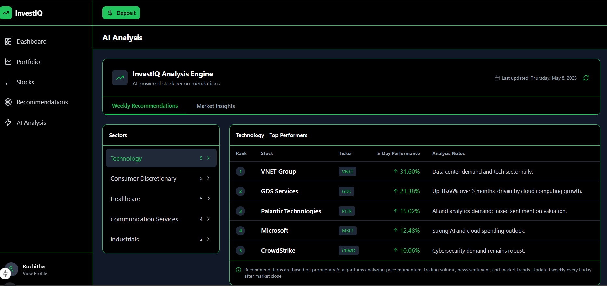
screenshots

Slide 62
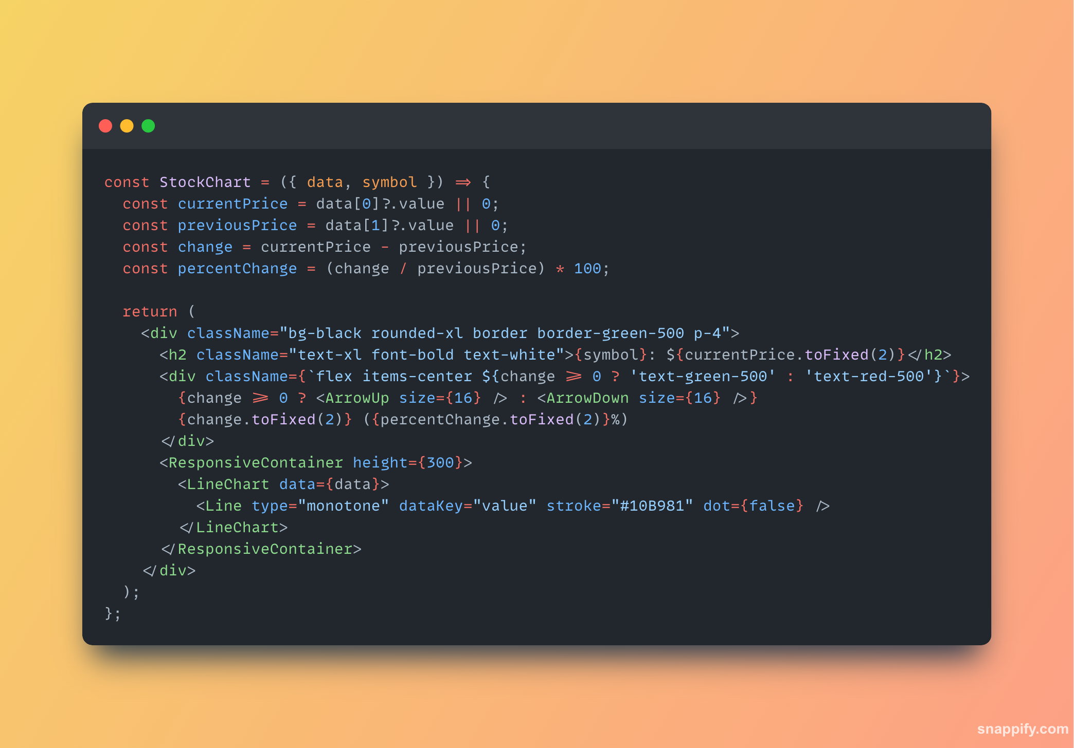
Code Snippets

Slide 63
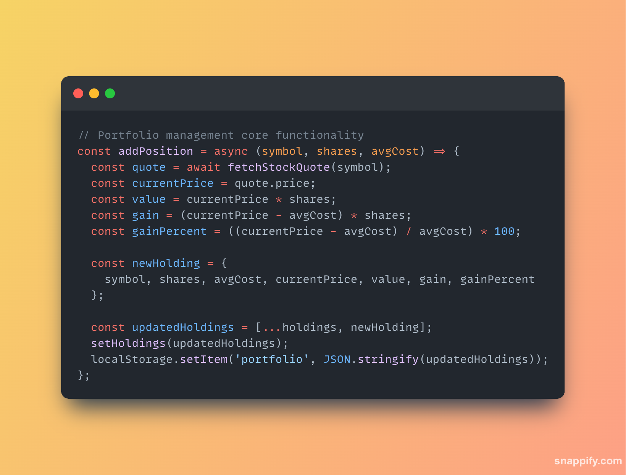
Code Snippets

Slide 64
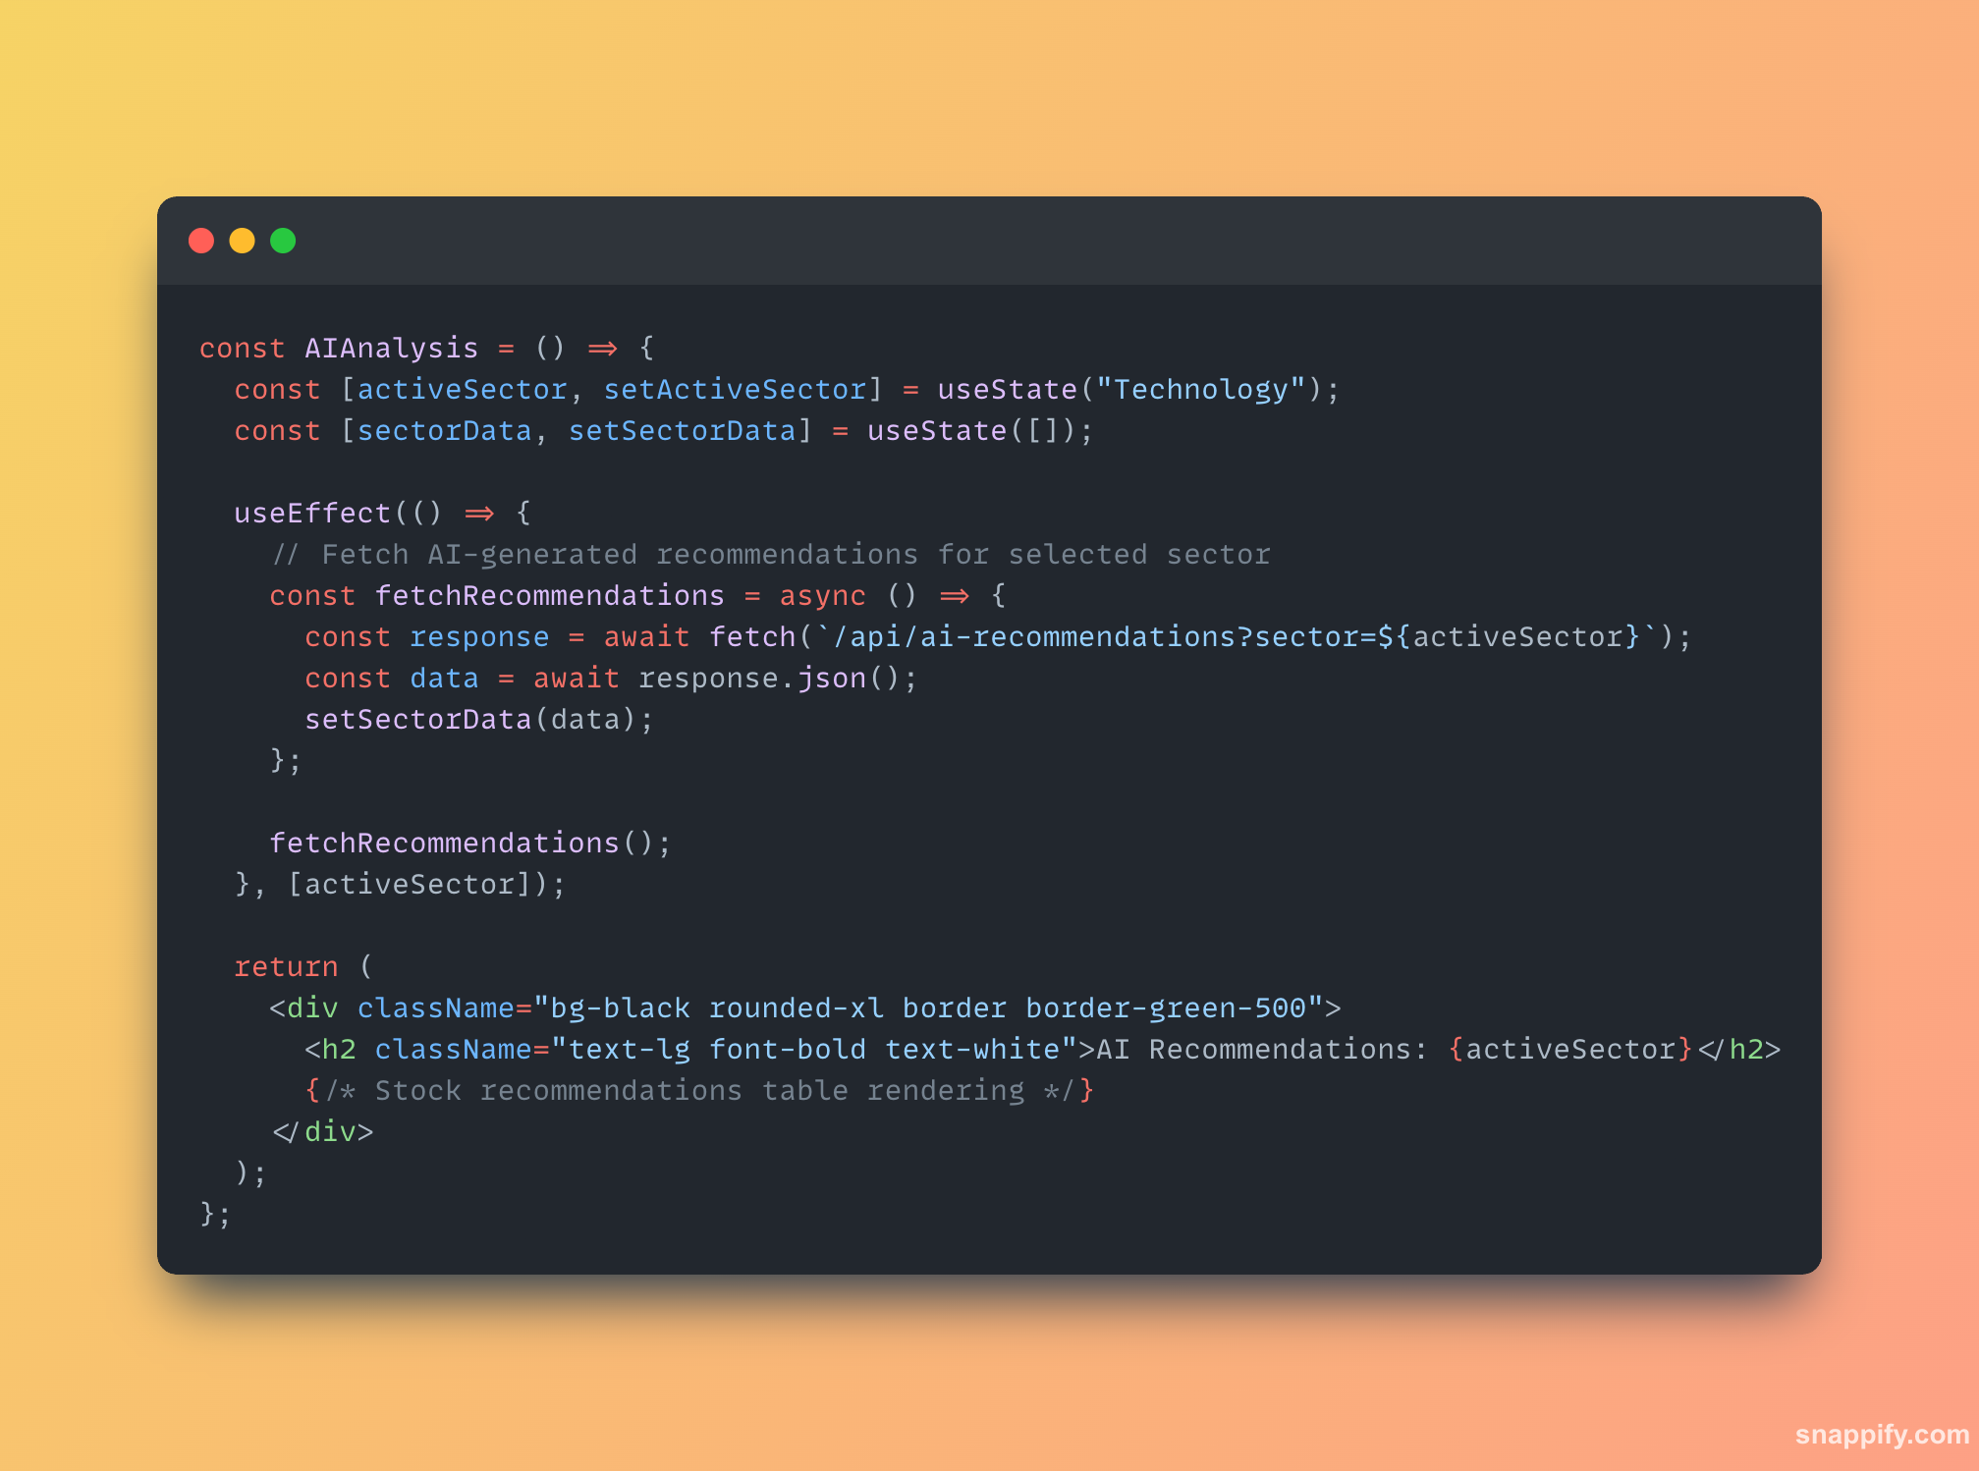
Code Snippets

Slide 65
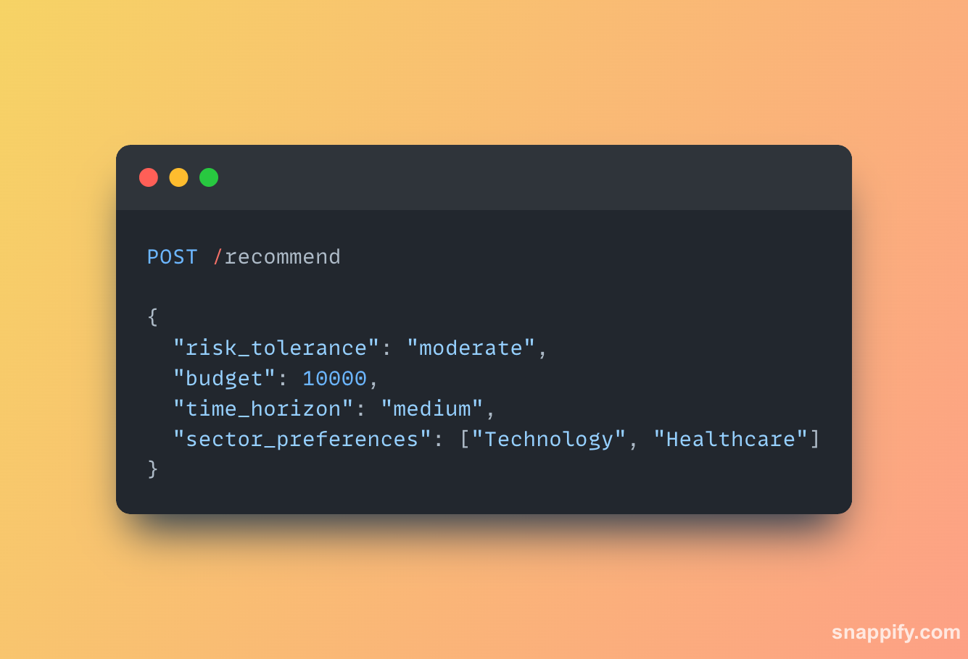
API

Slide 66
Wiki page link
https://github.com/htmw/2025S-Techno-Stack

Slide 67

Live Demo

Slide 68

Thank you

